Slide 1


Enable Private and Independent Communications Using The XMPP Protocol
By: Daniel Roldan

Slide 2

What is XMPP?
XMPP
X: Extensible
M: Messaging
P: Presence
P: Protocol

Slide 3
What is XMPP?
Developed by the homonym community in 1999
May 2000 Version 1.0 was released.
2002 Internet Engineering Task Force (IETF) formed XMPP
Today, tens of thousands of XMPP servers run today which is used by millions of users

Slide 4






What is XMPP used for?
Communications
User to user
Social Media
Gaming

Slide 5


What is XMPP used for?
Communications
User to user
Social Media
Gaming
User to device
Internet of Things (IoT)

Slide 6
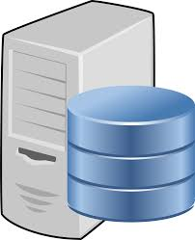
What is XMPP used for?
User to server
Request information
Server to server
Data Sharing

Slide 7




What popular applications uses xmpp?
Google: Cloud messaging
WhatsApp: Chat
Facebook: Chat
NATO (North Atlantic Treaty Organization): Tactical Chat
IETF: Online Meetings

Slide 8
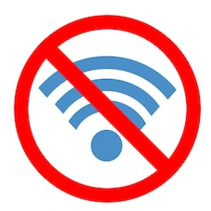
Why should we use it?
No internet connection required

Slide 9

Why should we use it?
No internet connection required
Private Communications

Slide 10

Why should we use it?
No internet connection required
Private Communications
Secure Communications
Encryption and Decryption

Slide 11
Why should we use it?
No internet connection required
Private Communications
Secure Communications
Encryption and Decryption
Manage your own communications

Slide 12

Why should we use it?
Manage how information is being stored

Slide 13

Why should we use it?
Manage how information is being stored
Manage who has access to the stored information

Slide 14
Why should we use it?
Manage how information is being stored
Manage who has access to the stored information
Can be implemented across different devices

Slide 15

Communications at NEIU
Communication between students
Tutoring

Slide 16

Communications at NEIU
Communication between students
Tutoring
Communication between students and professors

Slide 17

Communications at NEIU
Communication between students
Tutoring
Communication between students and professors
Communication between staff members

Slide 18
How does it All work?
User communicates to server
Server responds
Connects the source user to the destination user
Users are able to communicate with each other

Slide 19
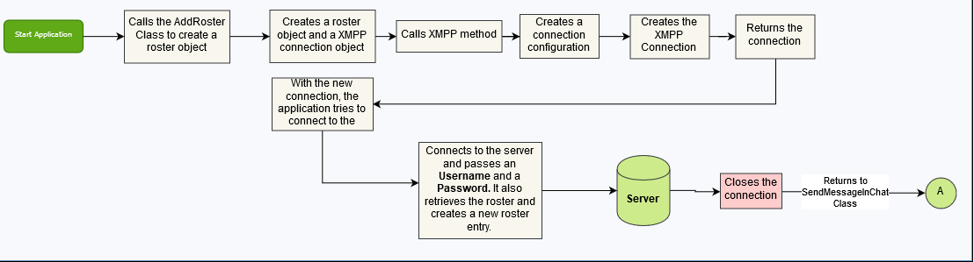
Application Process

Slide 20
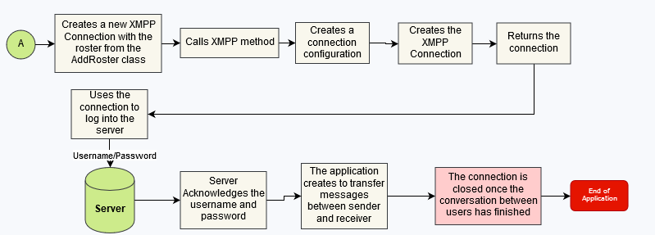
Application Process

Slide 21
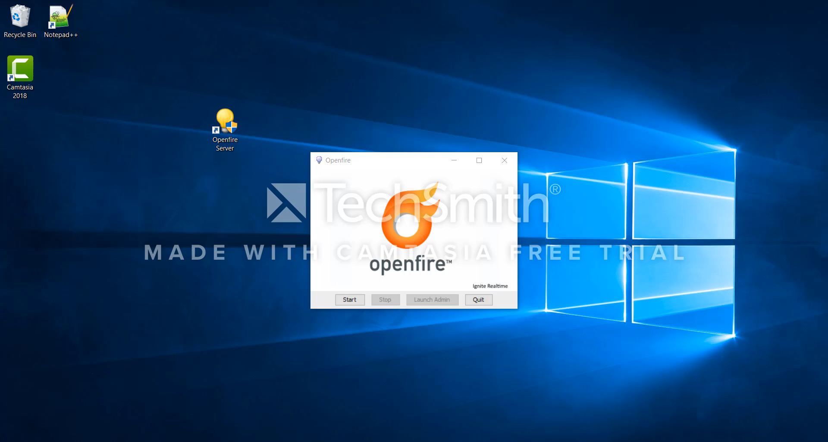
DEMO

Slide 22
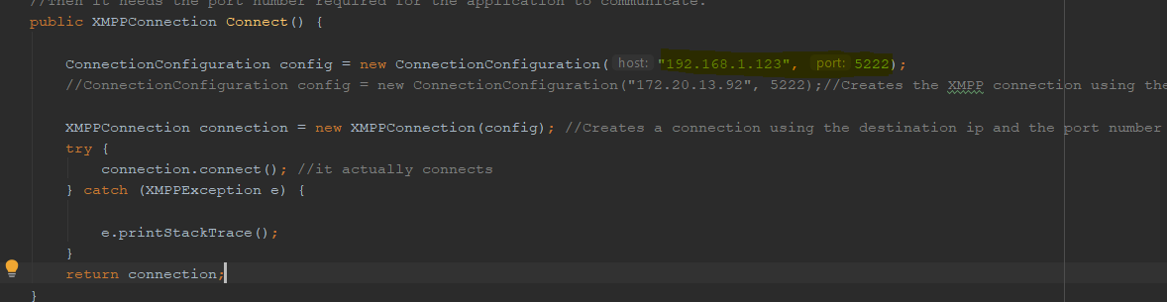
DEMO

Slide 23
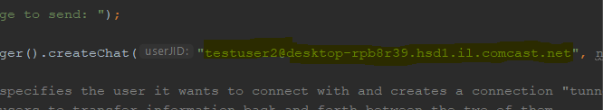
DEMO

Slide 24
Future of the Application
Implementation of an user interface (GUI)
Encryption & Decryption
Sharing of Documents and Files

Slide 25
Questions?

Slide 26
Thank you!

Slide 27
Sources
https://xmpp.org/about/technology-overview.html
https://xmpp.org/about/faq.html
https://xmpp.org/about/history.html
https://xmpp.org/about/

